Slide 1
A사 Range calibration

Slide 2
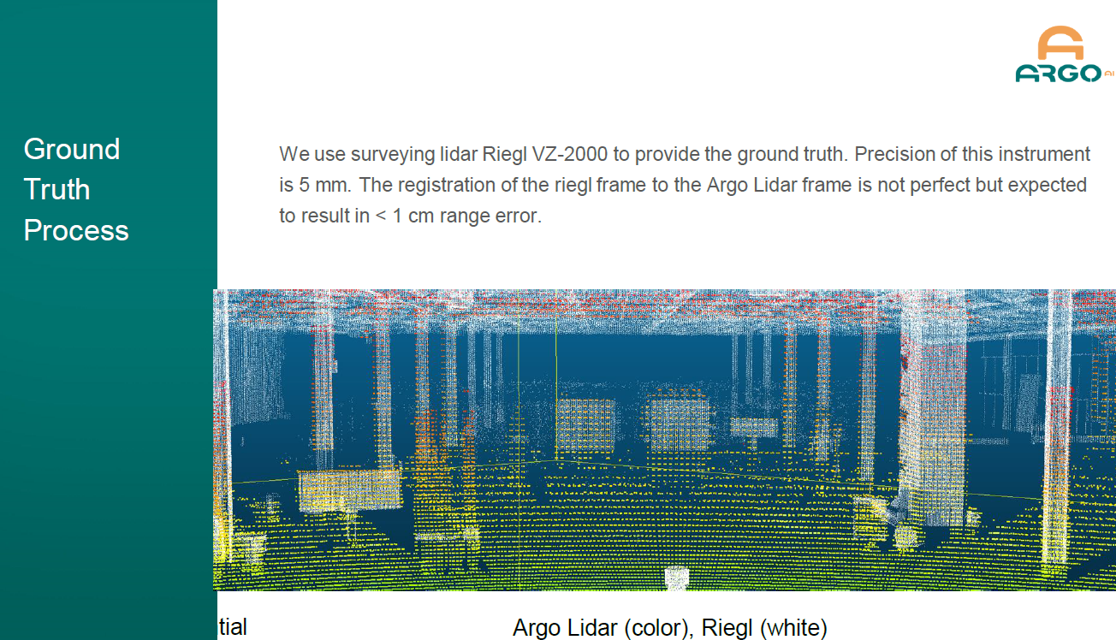
Range cal. & ground truth process
Cal. Region

Slide 3
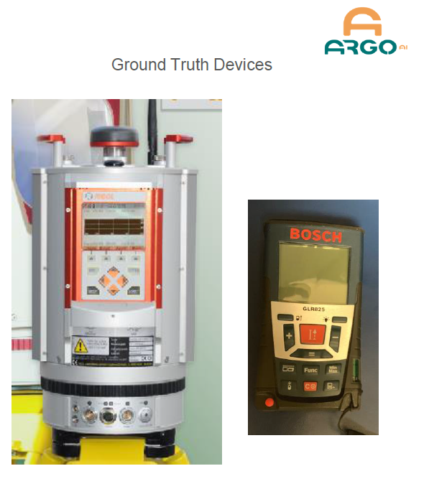
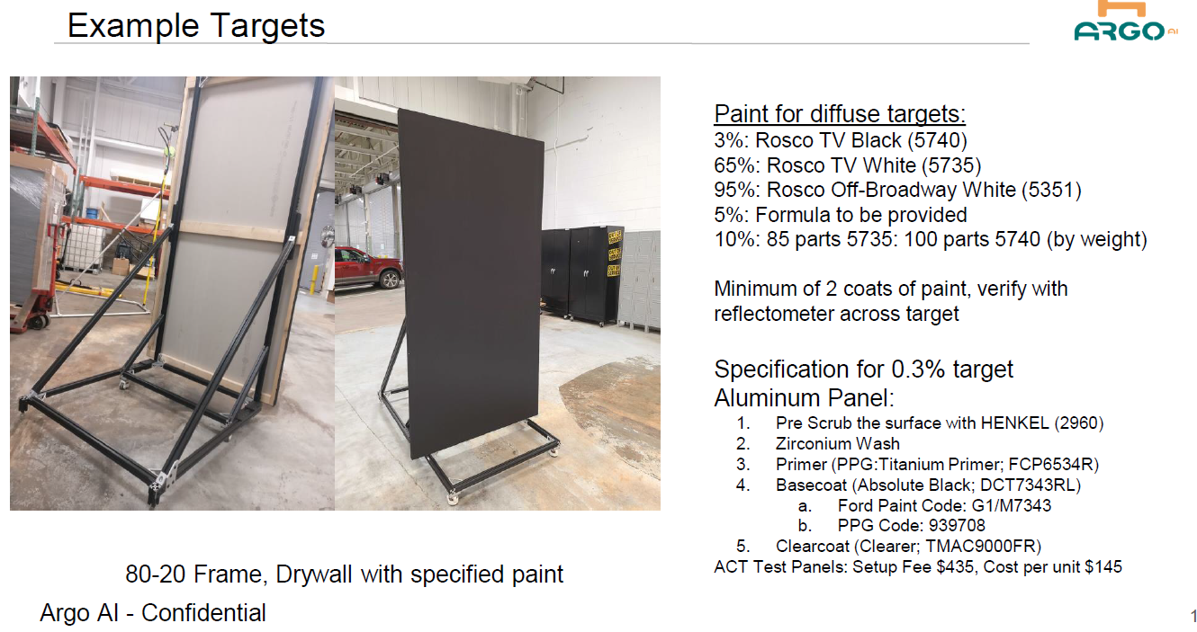
Ground truth and targets

Slide 4
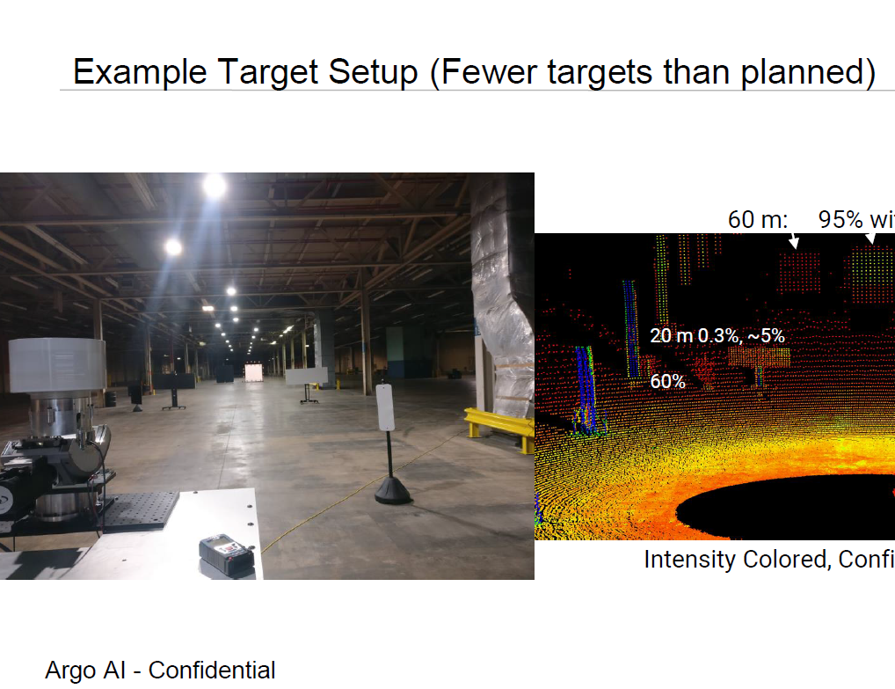
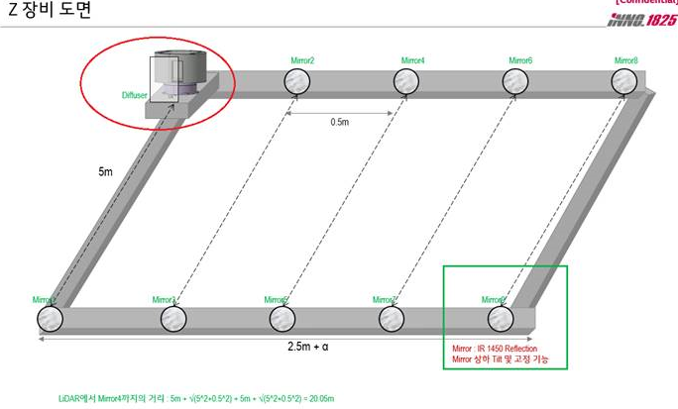
Test 환경
- Amber 환경 예시
- LiDAR cal. 과제 환경 예시

Slide 5
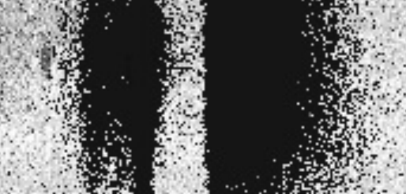
Range cal algorithm block diagram
- Range_calibration.py 파일
Function
Input data
Output data
Input range data
(ex. 0~250, .txt)
(Header →
Num azimuth
Num elevation
Num frames
)
Noise filtering(Median)
Target finding & boundary filter in denoised image
Exclude noisy Elevation line in original image
Range data accumulation by elevation line one frame
Range data accumulation by frames
Calculate offset with GT range
Range cal.
parameter
Lines to be accumulated
개선
points to be excluded

Slide 6
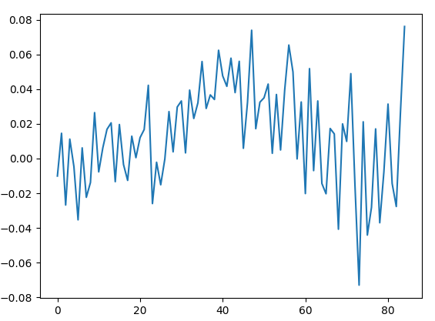
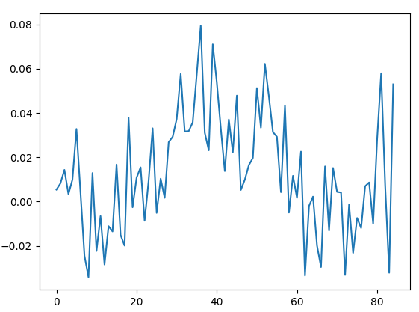
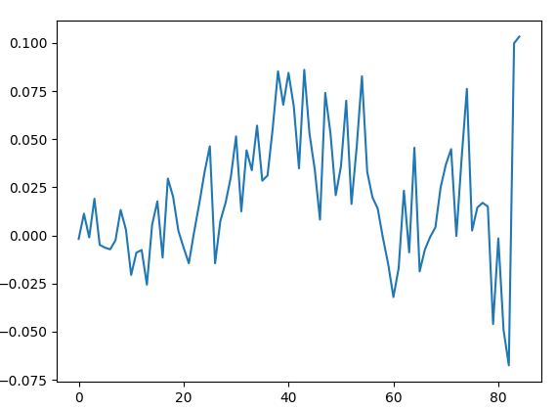
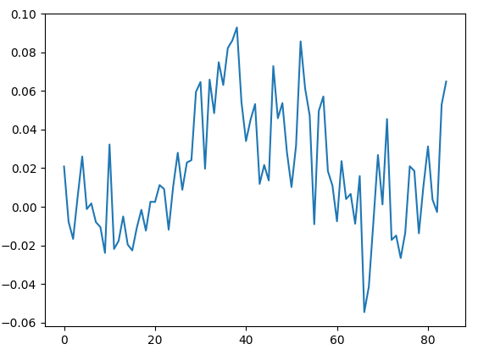
Range cal Results (단독 frame)
Range offset (meters)
Range offset (meters)
*Frame #1
*Frame #2
Superpixels(0~84)
Superpixels(0~84)
Range offset (meters)
Range offset (meters)
*Frame #3
*Frame #4
Superpixels(0~84)
Superpixels(0~84)

Slide 7
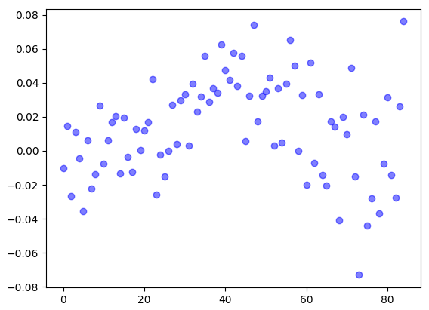
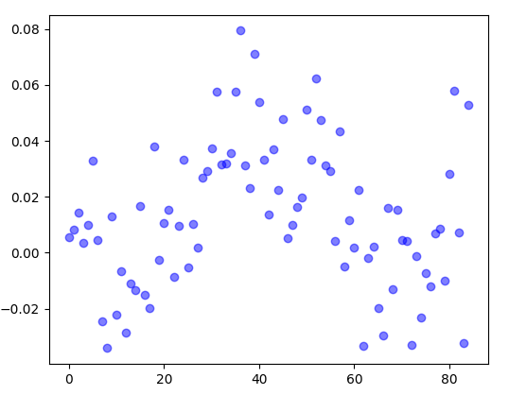
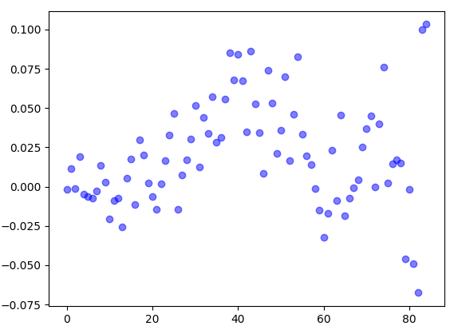
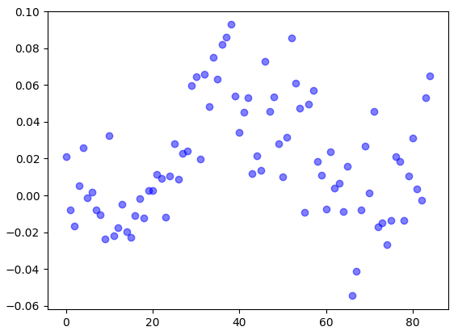
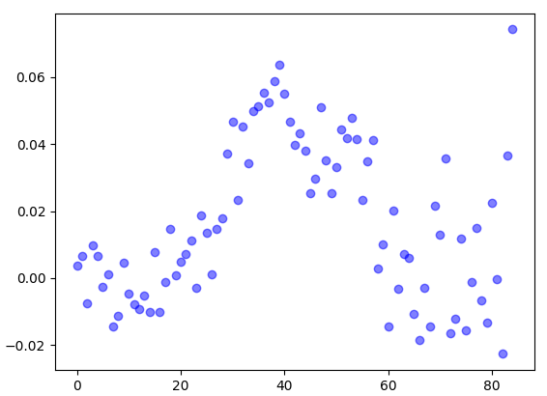
Range cal Results (4 frames 누적)
Frame 1
Frame 2
Frame 3
Frame 4
Frame 1~4 accumulated

Slide 8
Range cal Results 비교 (4 frames 누적 vs Amber vs Gate 1. result)
*New algorithm
*Amber & Gate1. result

Slide 9
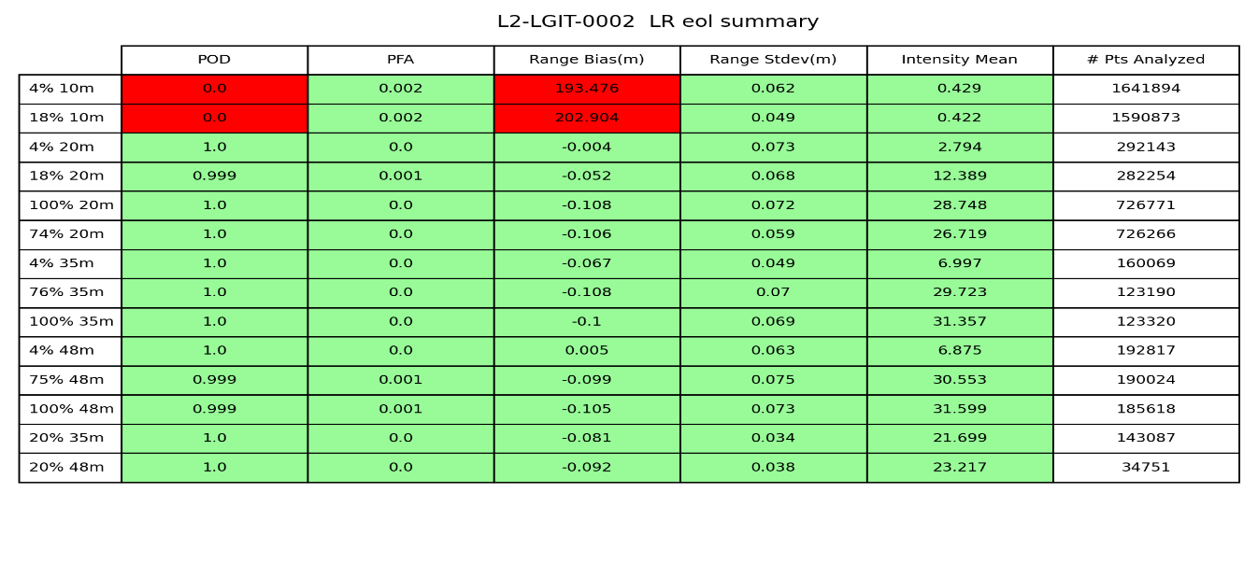
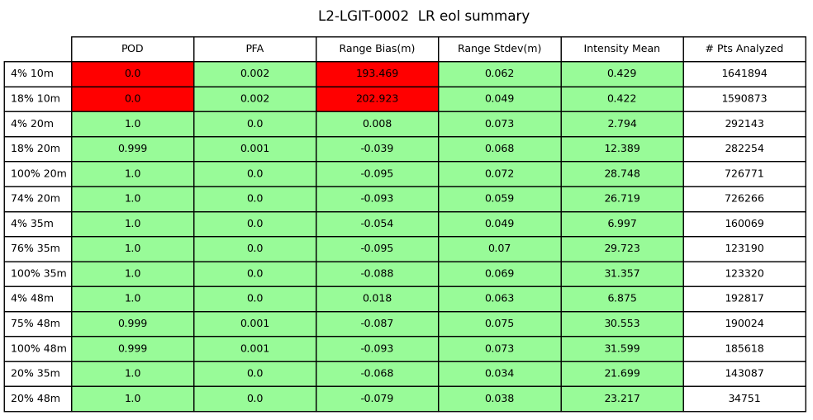
Amber vs Sprint.4 validation결과 비교
소제목
Amber
Sprint review

